Slide 1
Smart Testing Console

Slide 2
Purpose
Making Software testing easier for Non-technical & the people who are unfamiliar with Jenkins

Slide 3
Project 1: Maven Automation
Based on Java, Maven & surefire, implements Playwright Testing library for test demonstration, TestNG for management and orchestration and aventstack’s Extent Report for report generation
Implements Multiple Test Cases both for Web Scraping and API testing, test grouping with test suites
Implements parameterized configuration which can dynamically change the Browser used, Log mode, Head-less mode for testing through multiple sources such as maven parameters, suite parameters and default parameters
Implements custom report generation and sending over email using TestNG & javax.mail

Slide 4
Project 2: Smart Test Console
Based on Java, Spring-Boot as Backend, Typescript, React as frontend and Jenkins as Data source
Leverages Jenkins Rest API for processing and building jobs
Implements Spring boot as a proxy server that securely stores the credentials and data
Leverages React frontend for easy Visual interaction for not tech users
Supports Folder traversal, Job detail listing, previous build history, Job trigger with/without parameters, Triggering job with custom selected test cases, Generative AI integration for Job Faliure resolution

Slide 5
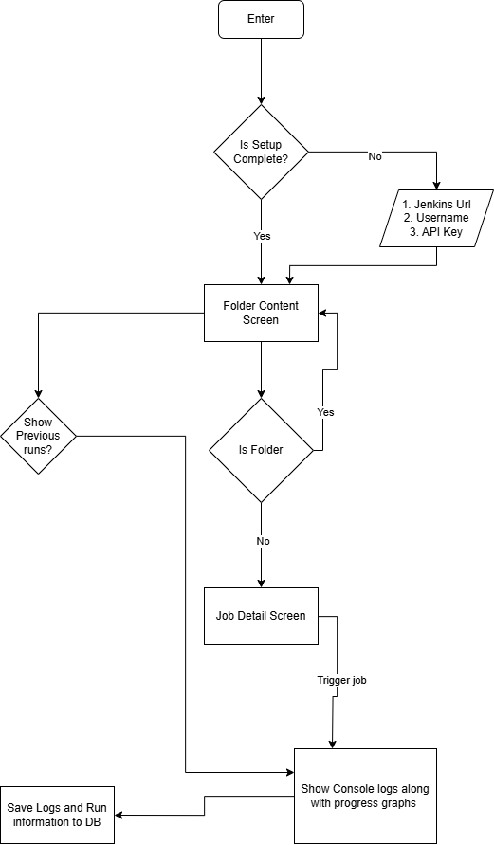
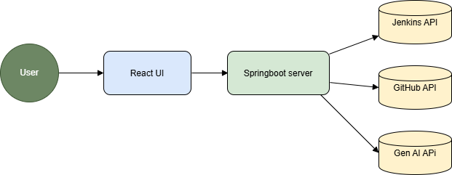
User Flow Diagrams

Slide 6
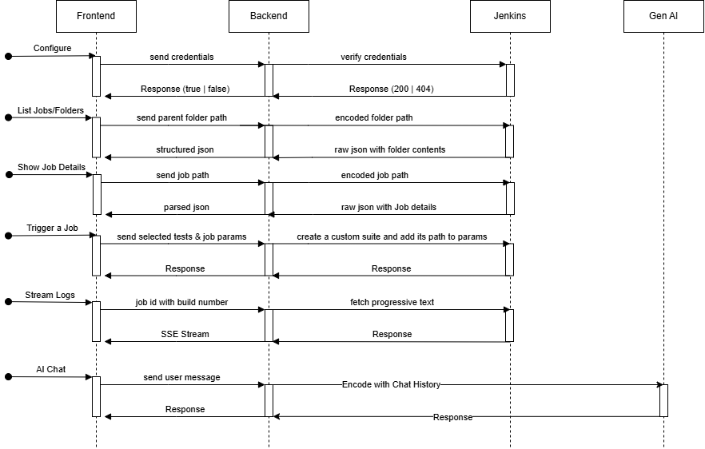
Sequence Diagram

Slide 7
Thank you
Khushal Jangid
khushal.jangid@accenture.com

